Slide 1

Breast Cancer Prediction
BA723 - Business Analytics Capstone
Presented by Aisha Akter Anamika

Slide 2



Introduction
Breast cancer remains the most diagnosed cancer among women aged 40 to 60, contributing significantly to global cancer mortality. With over 7.6 million cancer-related deaths annually, 502,000 are attributed to breast cancer alone, according to the World Health Organization. These alarming figures highlight the urgent need for improved diagnostic tools that can support early detection and treatment.

Slide 3
This project introduces a predictive modeling framework using image-derived features from fine needle aspiration (FNA) procedures. By testing and comparing seven statistical and machine learning models through 569 samples from a dataset collected from Wisconsin, U.S.A. The research identifies the most effective approach for classifying tumors. The goal is to maximize recall for malignant cases, reduce diagnostic delays, and improve cost-efficiency in healthcare delivery by supporting faster, more accurate, and scalable cancer detection methods.

Slide 4


Assumptions
Real-World Data
Early Self-Assessment
01
The dataset closely represents real-world breast cancer cases, ensuring practical relevance.
03
Predictive modeling, while not flawless, supports early self-assessment and encourages timely medical consultation.
Accessible Users
Clinical Confirmation
02
Intended for users with basic digital literacy and reliable access to smartphones or computers.
04
This model serves as a support tool, with clinical diagnosis still essential for final confirmation.

Slide 5
Business Scenario
Traditional diagnostic methods often rely on expensive imaging technologies and expert pathologists, which may not be scalable or accessible for preliminary screening. This leads to delayed diagnoses, increased treatment costs, and worsened patient outcomes.
🚨The Core Business Problem🚨
How can we bridge this gap by developing a cost-effective, interpretable, and scalable AI model that enhances early-stage breast cancer detection, supports healthcare professionals, and expands access to underdiagnosed populations?

Slide 6


The solution
Predictive Modelling for
Breast Cancer Diagnosis
Using regression-based predictive models to identify benign and malignant breast cancer cells

Slide 7
Why regression models?
Regression models observe the relationship between variables and make predictions. Forward/Backward/Stepwise regression automatically choose the most important predictors which in our case is highly affective to determine which factors contribute most to identifying cancer cells.

Slide 8
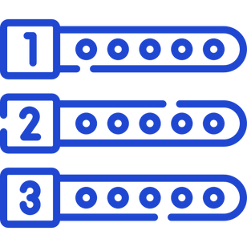




Approach to model selection
Numerical Performance
Simplicity
Statistical Validity

Slide 9
Model Selected - Stepwise Regression
RECALL
F1
97
95
%
%

Slide 10



STEPWISE REGRRESSION
Numerical Performance
Recall
F1
Captures more malignant cases, avoids false negatives. Involves high degree of risk.
Balances precision and recall.

Slide 11


STEPWISE REGRRESSION
Simplicity
Used only 5 predictors, fewer than forward (10) and backward (9).
Easier to interpret, faster to train, more scalable.

Slide 12


STEPWISE REGRRESSION
Statisical Validity
All p-values < 0.01.
stable and consistent odds ratios
VIF scores consistently ≈ 5 or lower
PSI < 0.10 for all predictors so no significant data drift.

Slide 13


Most important variables
Variable | Explanation
concave points_worst | Strongest positive predictor of malignancy - higher values greatly increase the odds of cancer being malignant.
radius_se | Positive association - indicates size variation impacts malignancy likelihood.
texture_mean | Positive association - indicates size variation impacts malignancy likelihood.
concave points_se | Negative predictor - higher values reduce malignancy odds.
radius_mean | Positive predictor - larger average radius increases likelihood of malignancy.

Slide 14

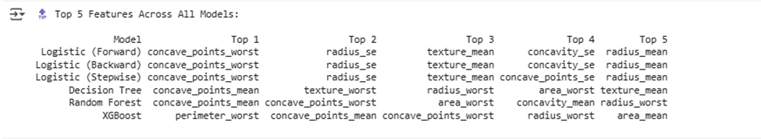
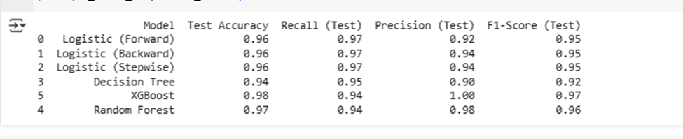

Model Summary

Slide 15
Post-model development roadmap
Comprehensive Model Validation
Test the model on completely unseen and minimally processed (“organic”) datasets.
Evaluate performance across diverse datasets and scenarios to ensure metrics align with clinical requirements and remain consistent.
Compare results with other high-performing models such as Random Forest and XGBoost for potential future integration.
Pilot as a Decision Support Tool
Implement the model in small settings to be tested by business analysts and software developers/engineers.
Iterative Improvement
Use pilot results to identify technical enhancements and refine the model before developing it as a product such as Mobile App, Web/Cloud API, and Hospital System Integration.
Real-Time Monitoring & Maintenance
Continuously track key performance metrics after pilot. Implement scheduled retraining to adapt to new data and maintain accuracy.
Full Integration
Once validated and optimized, integrate into professional settings.

Slide 16
Business Recommendations
Low-Cost Deployment
User Feedback & Tracking
Implement the product in affordable, accessible, and scalable screening programs (small clinics/medical research centers) to enhance early breast cancer detection and reduce diagnostic delays through community healthcare initiatives.
Gather user input and monitor diagnosis results to evaluate performance and identify areas for improvement.
Workflow Integration
Collaborative Partnerships
Upgrade the product for seamless integration into existing healthcare workflows, improving efficiency and adoption.
Work with medical institutions and public health agencies to support market adoption and ensure successful product deployment.

Slide 17


Thanks!
Questions?

